Slide 1
Automated Attendance System
Using Machine Learning

Slide 2




Group 06
Md. Asaduzzaman Sunny
Md Jalal Abedin Pial
Kazi Adbullah Al Hasnaine
Al Amin
-2211702 642
-2211158 642
-2211688 642
-2212251 042

Slide 3
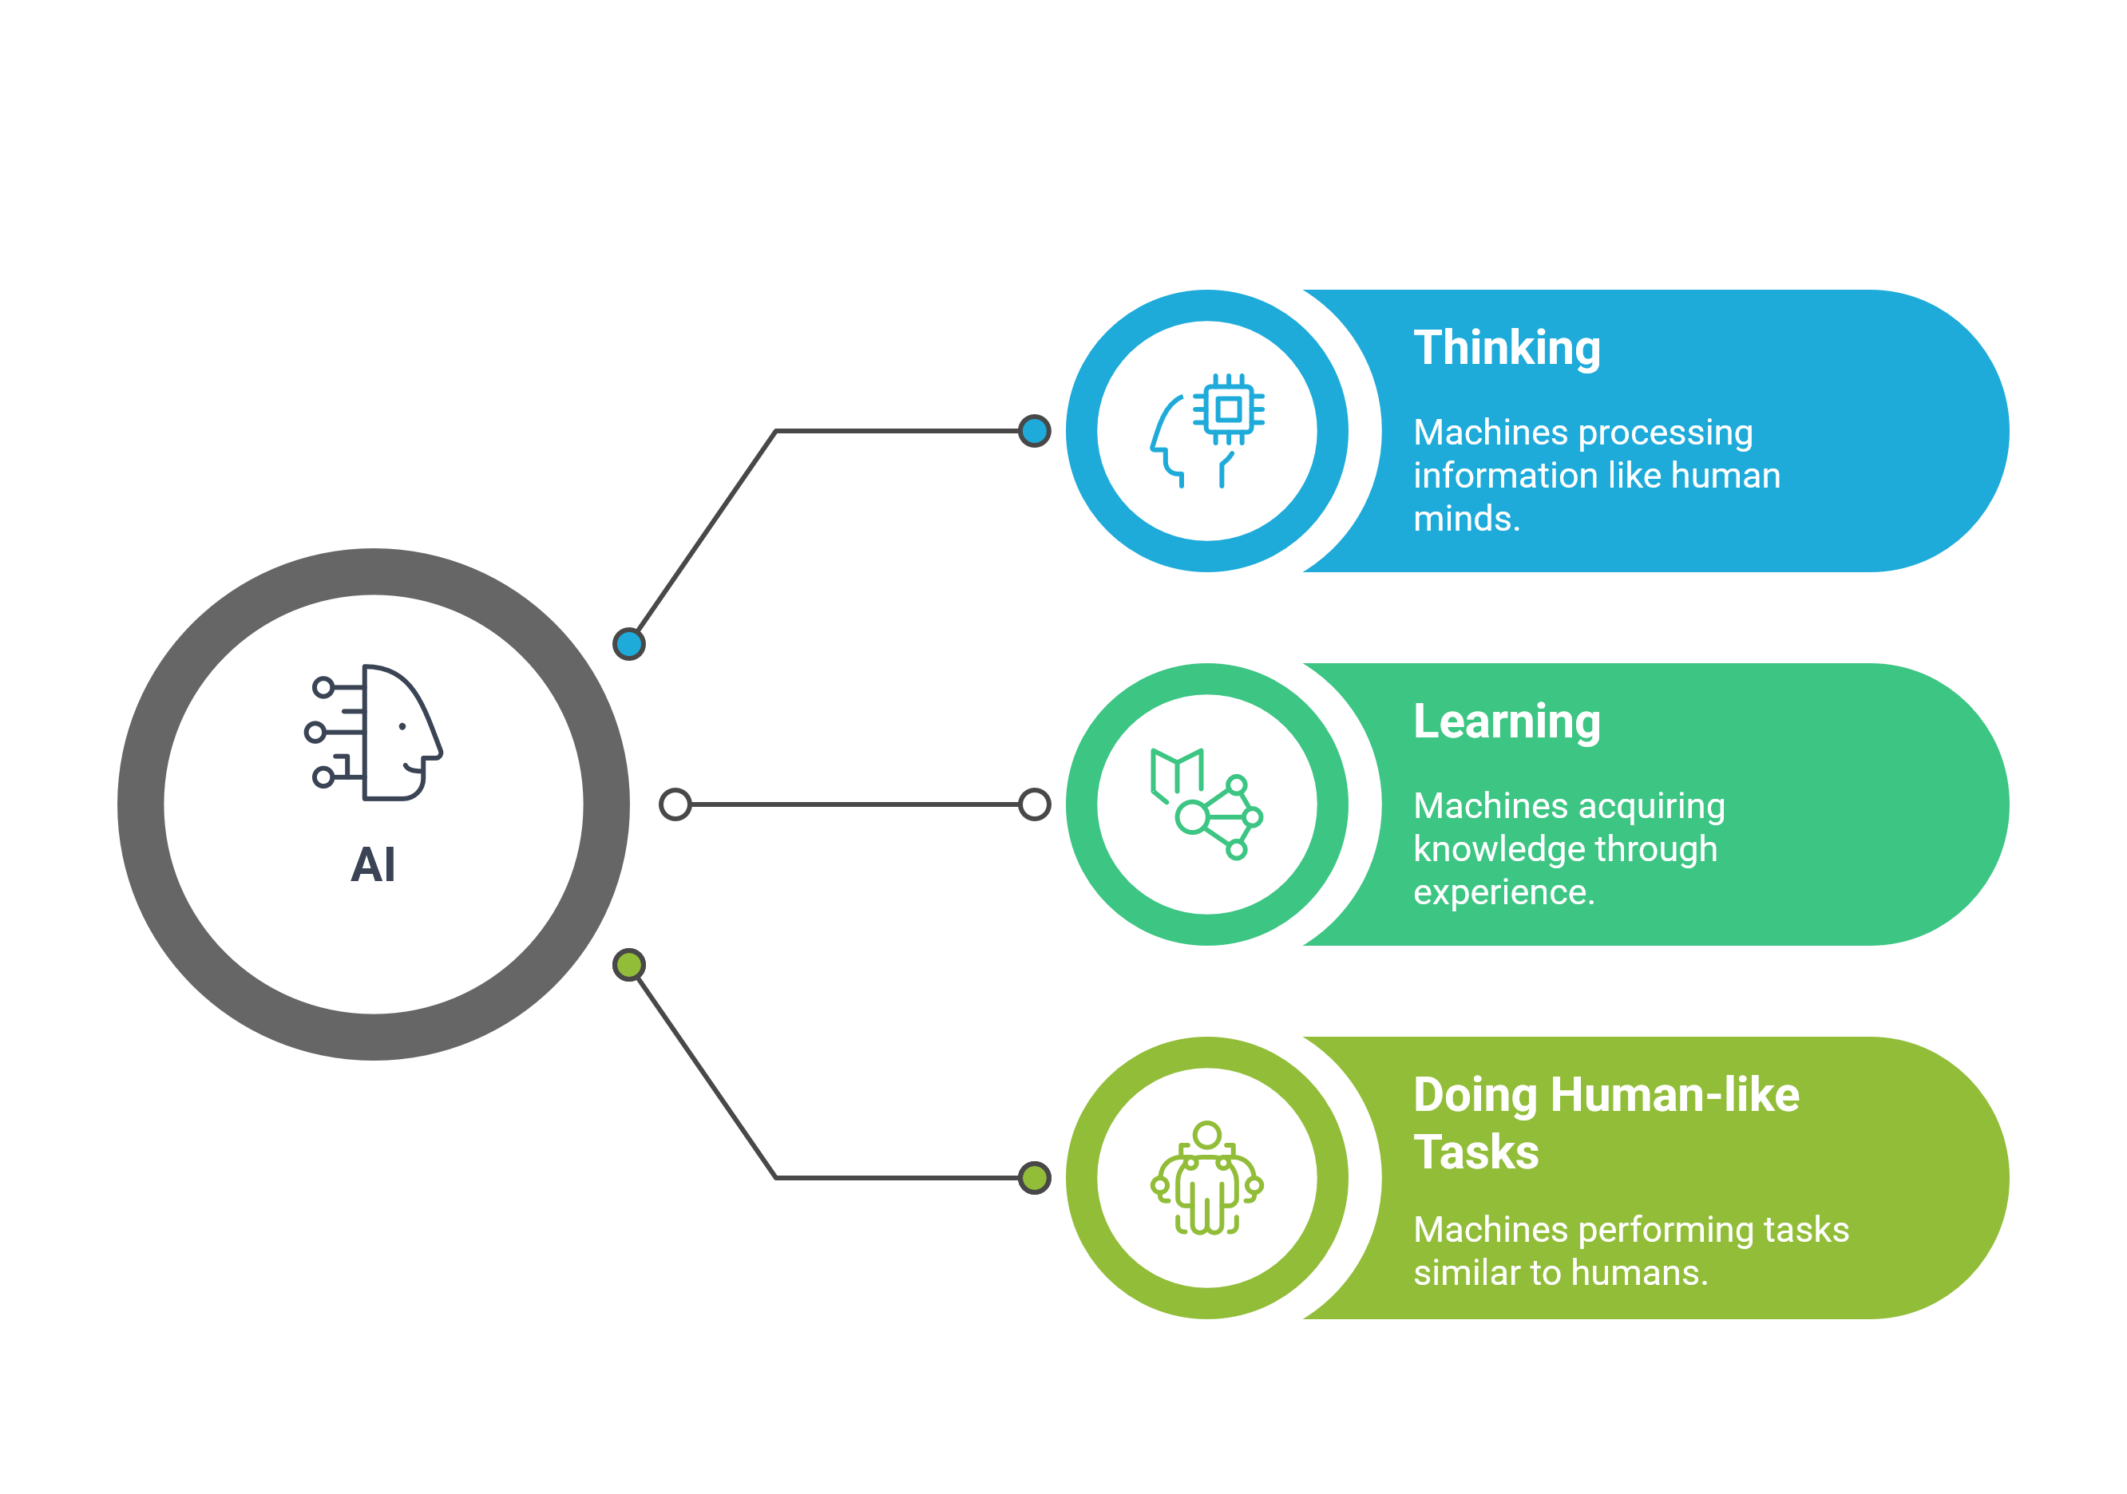
What is AI?

Slide 4
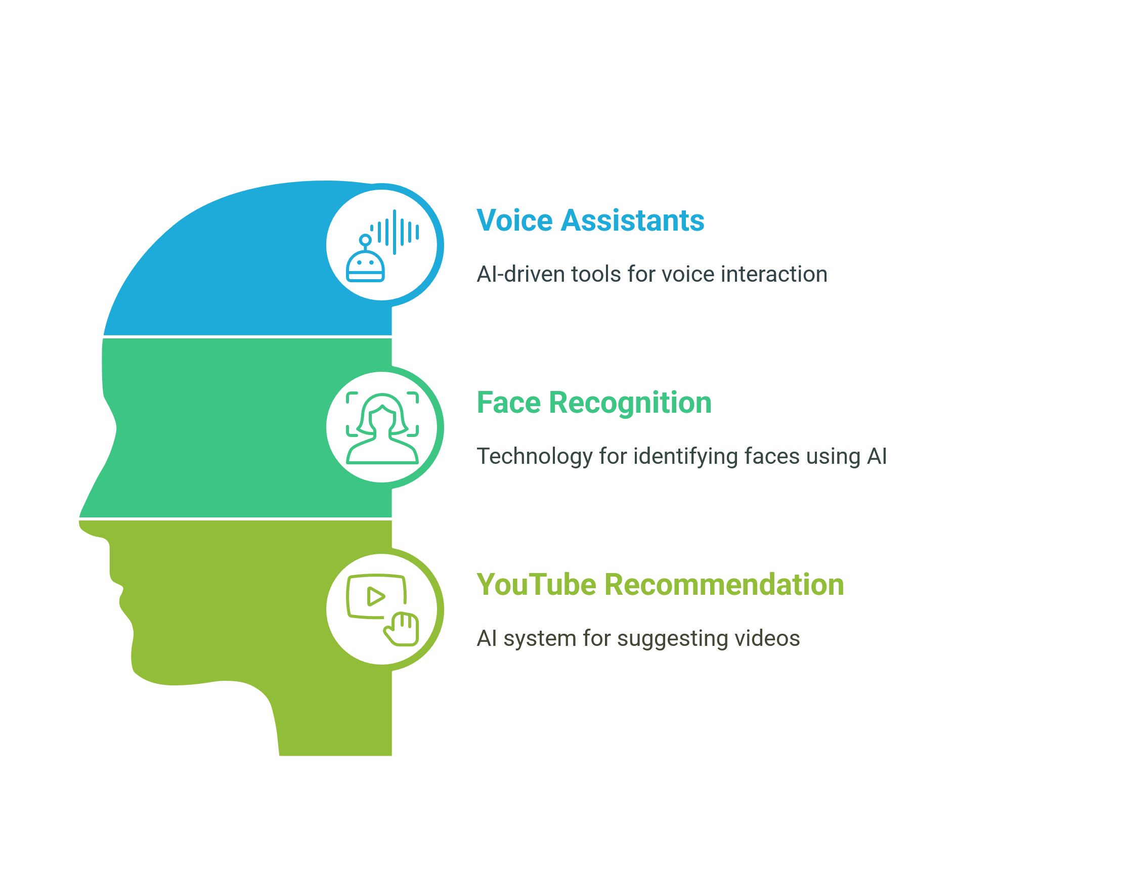
Applications of AI

Slide 5
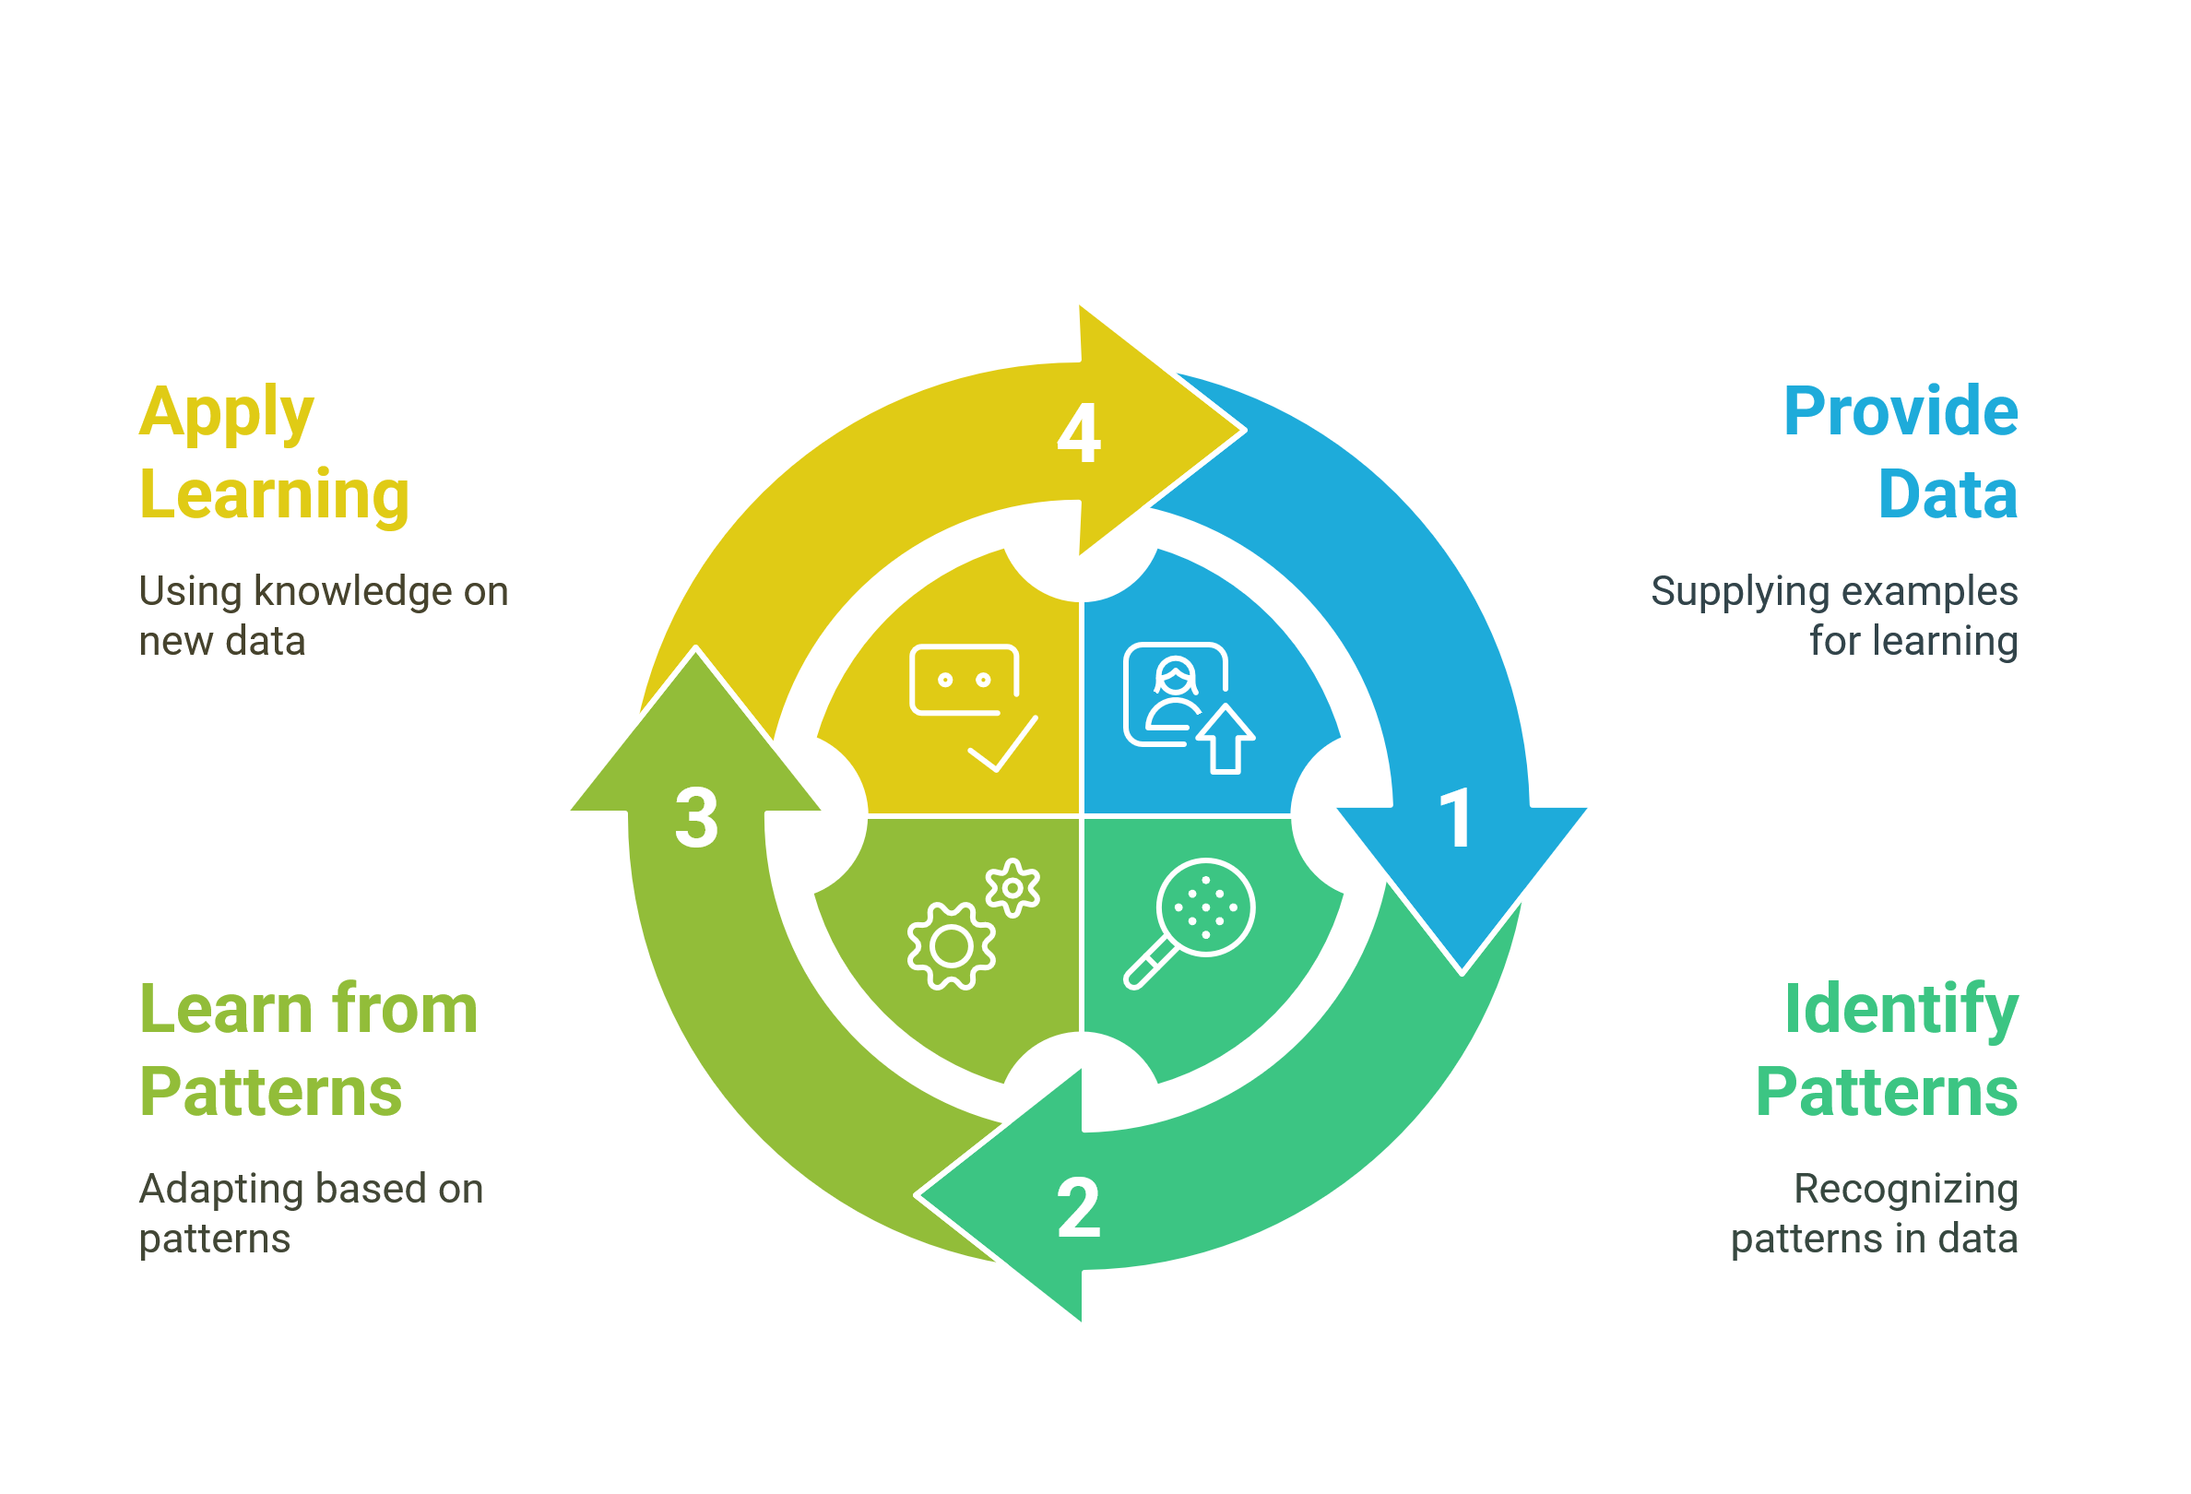
How Does Machine Learning Works?

Slide 6
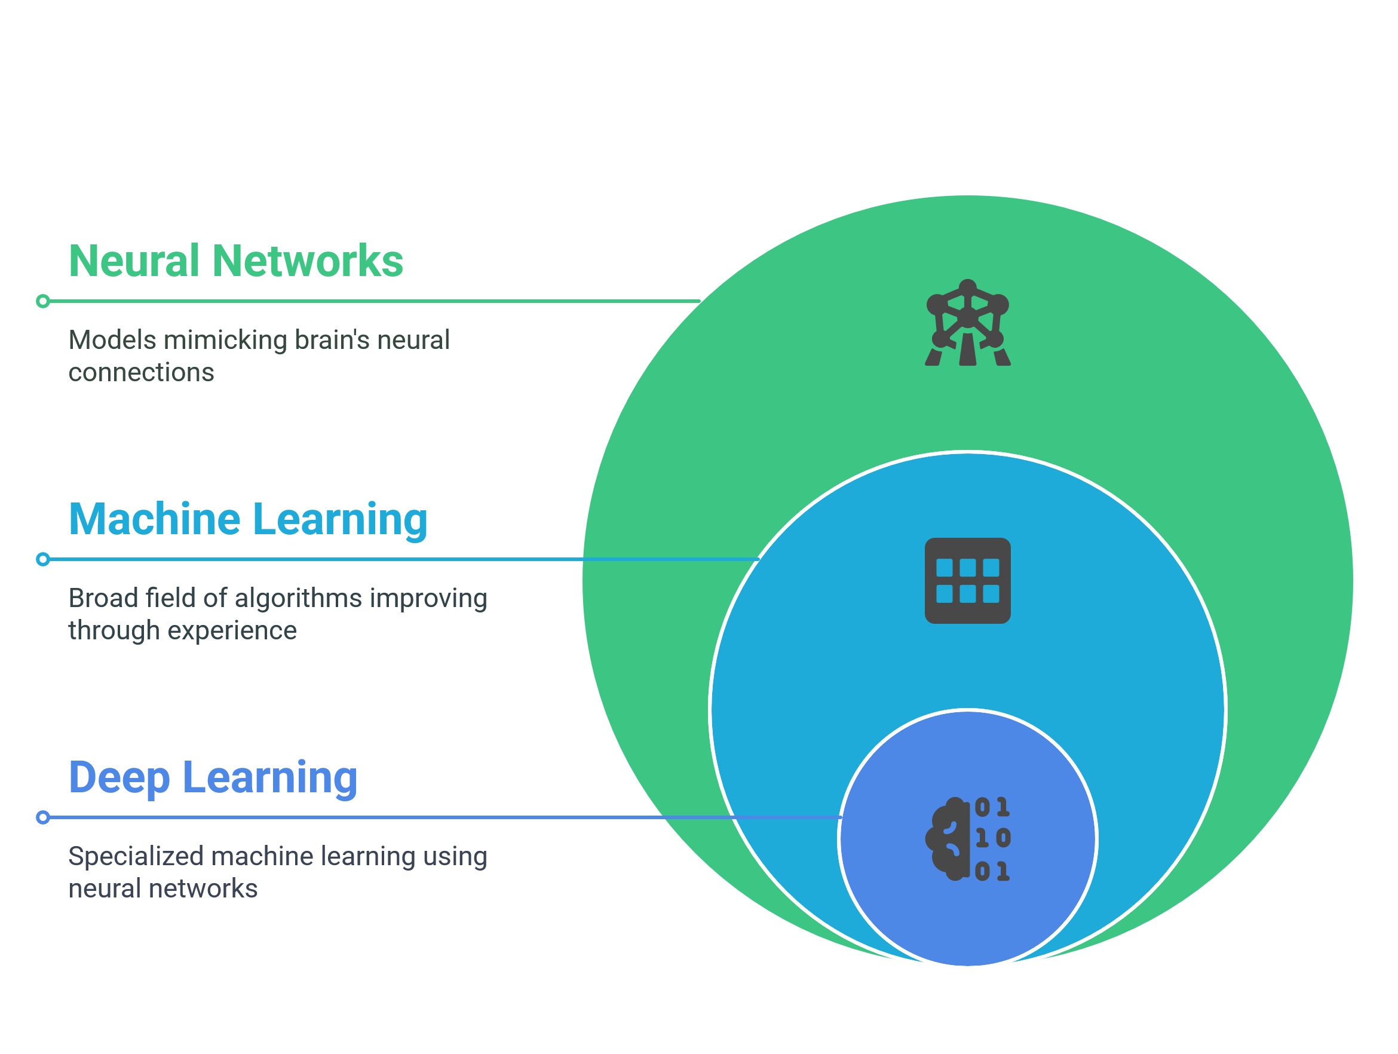
What is Deep Learning?

Slide 7
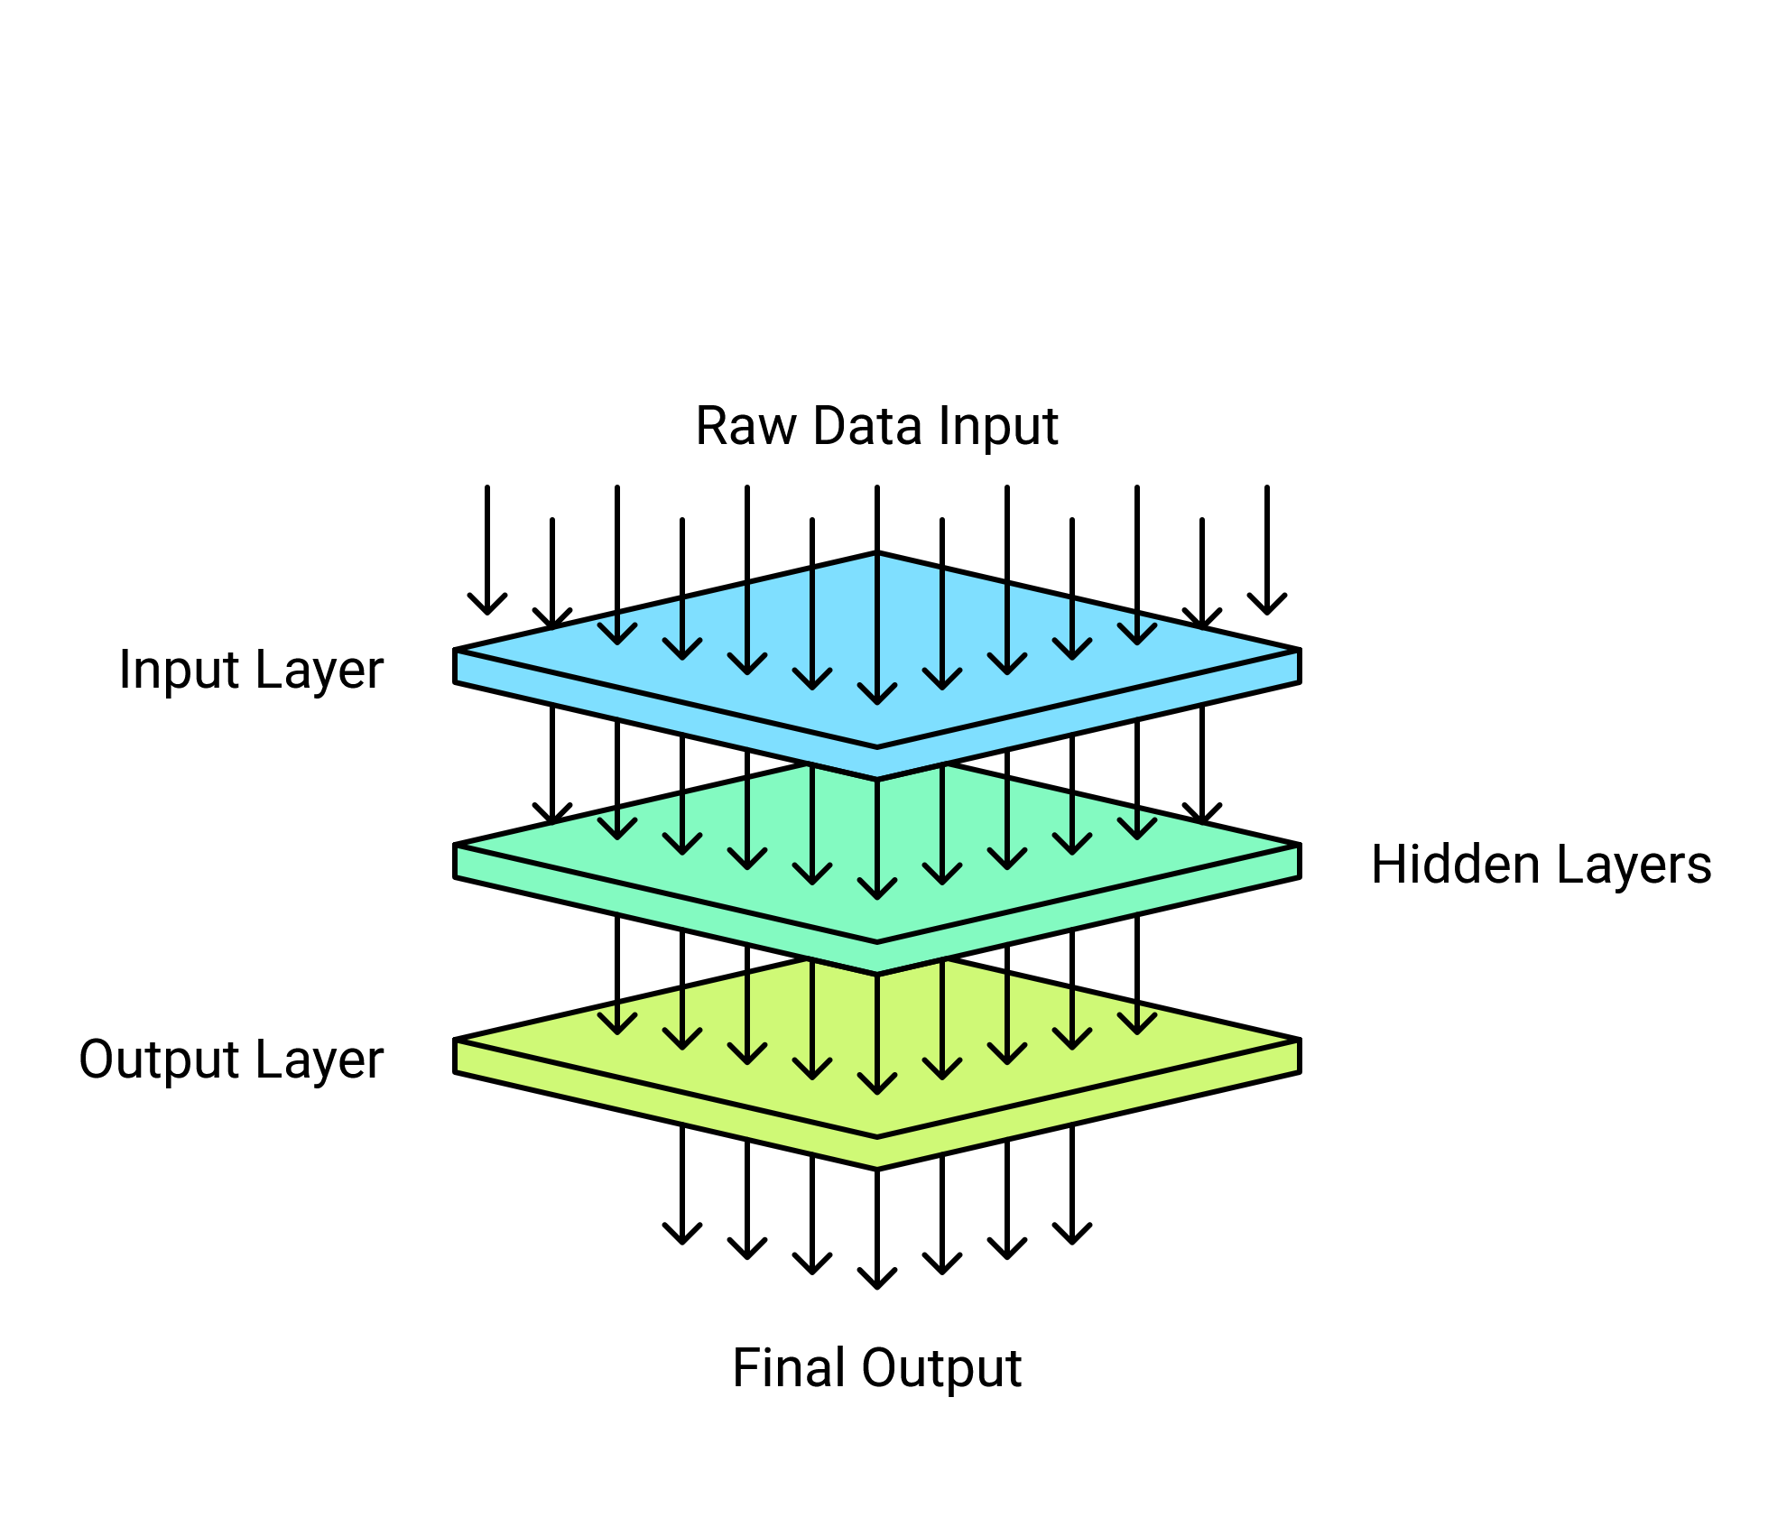
Layers of Artificial Neurons

Slide 8
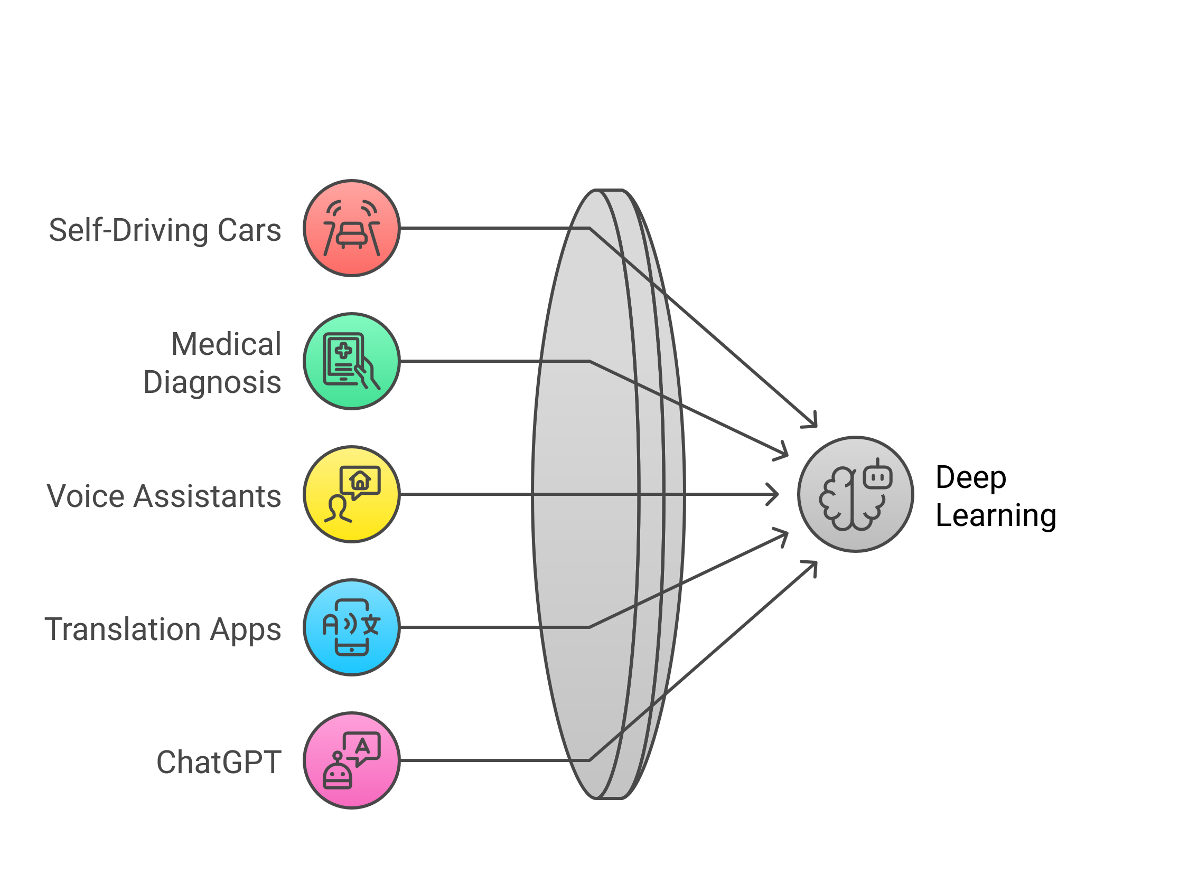
Examples of Deep Learning

Slide 9
Showcase

Slide 10
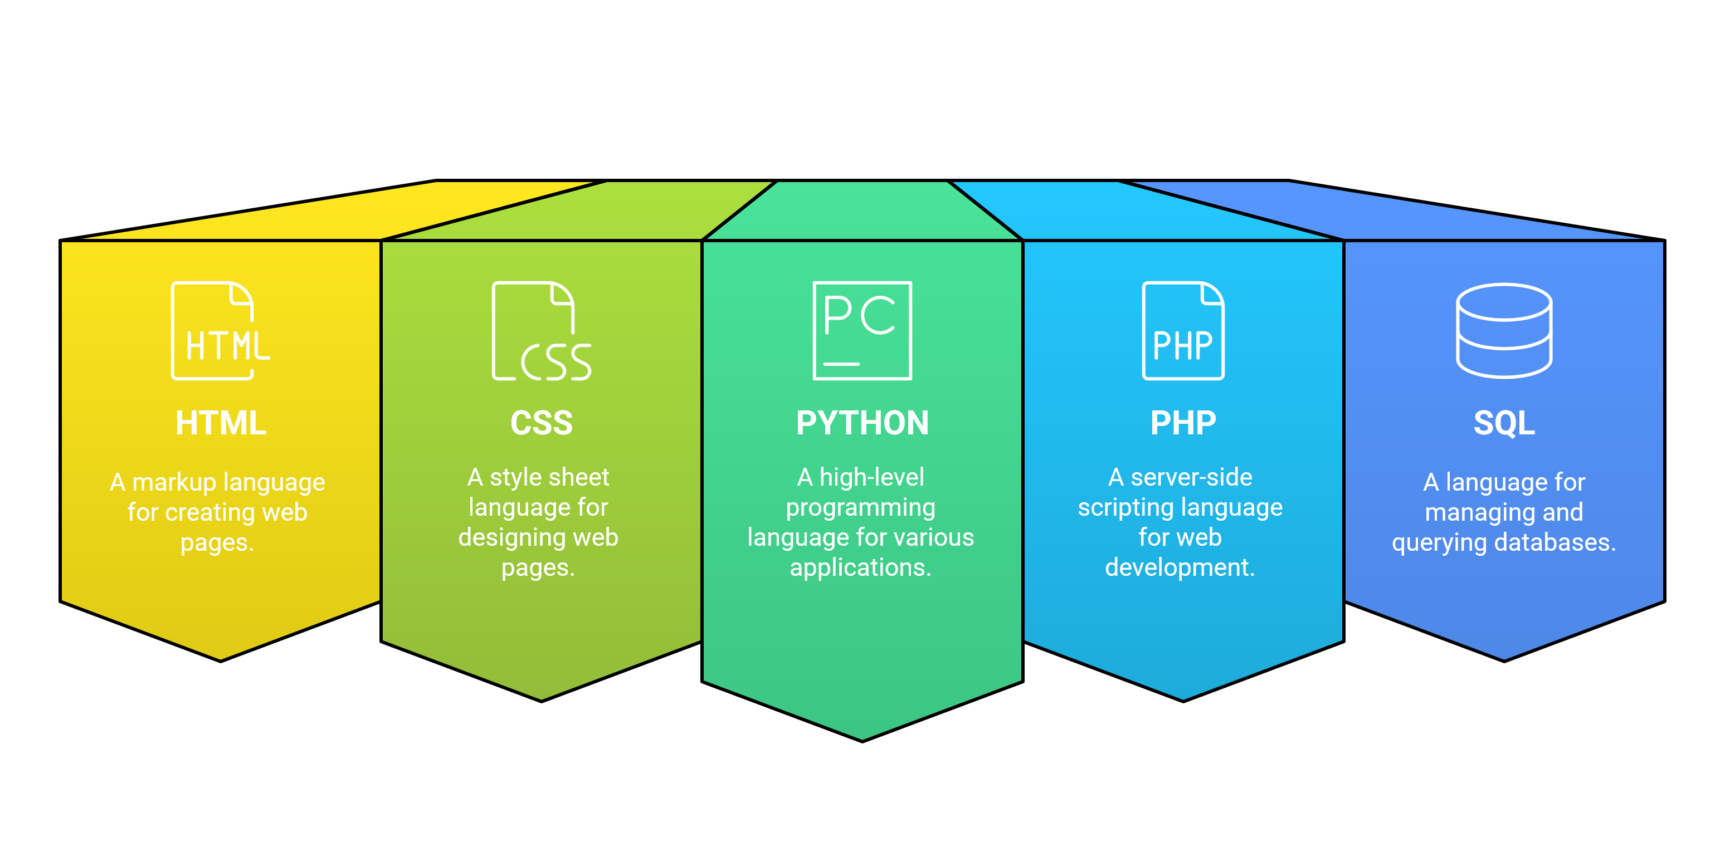
Core Tools Used

Slide 11
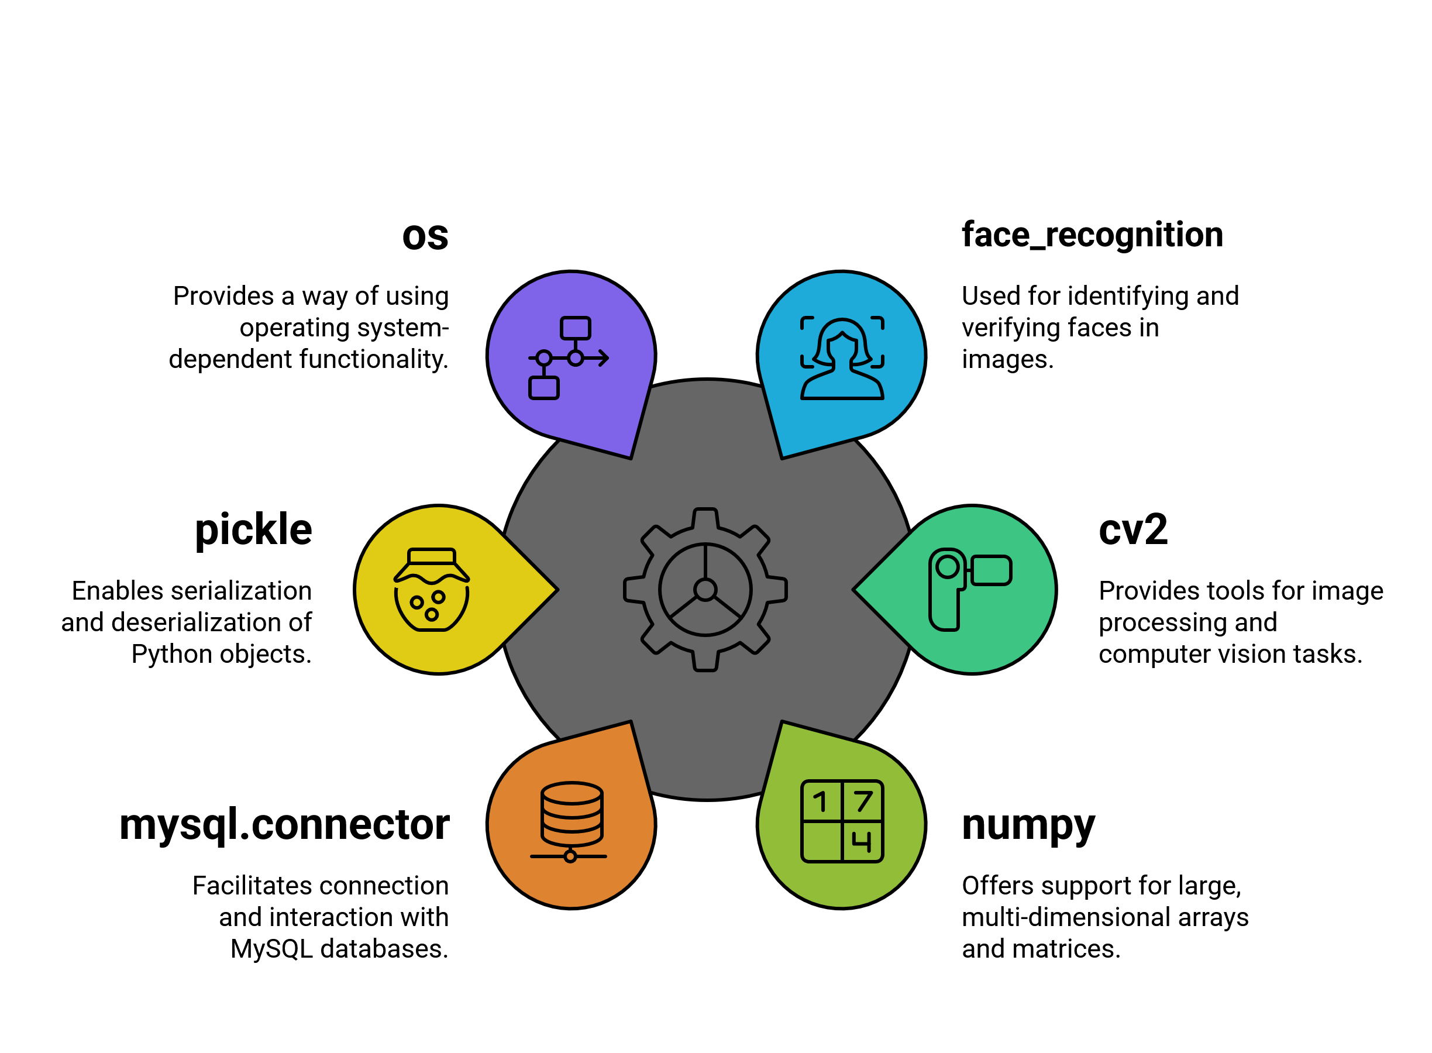
Libraries used

Slide 12
Numpy 2.4.4 ❌
face_recognition 1.3.0
Numpy 1.26.4 ✔

Slide 13
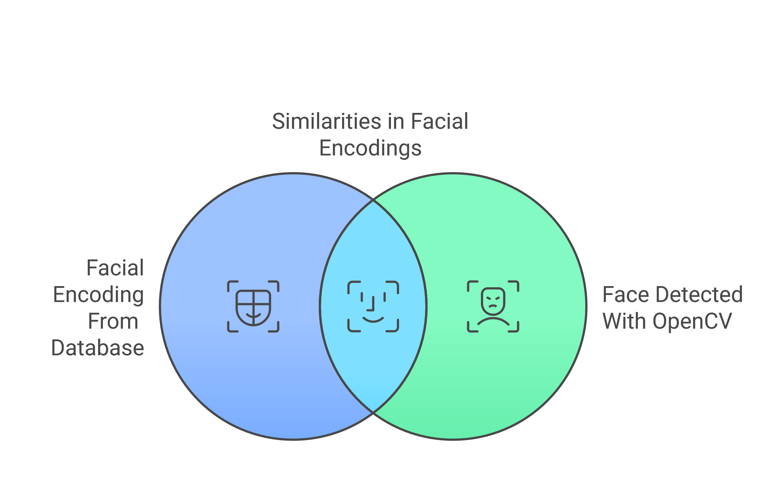
How Does face_recognition Works?

Slide 14
Future Plan
01
02
Real-time Notifications
Enhanced Accuracy
03
04
Data Analytics
Mobile Compatibility

Slide 15
Thank You!

